Slide 1
Synaptic Plasticity (Chapter 8)

Slide 2
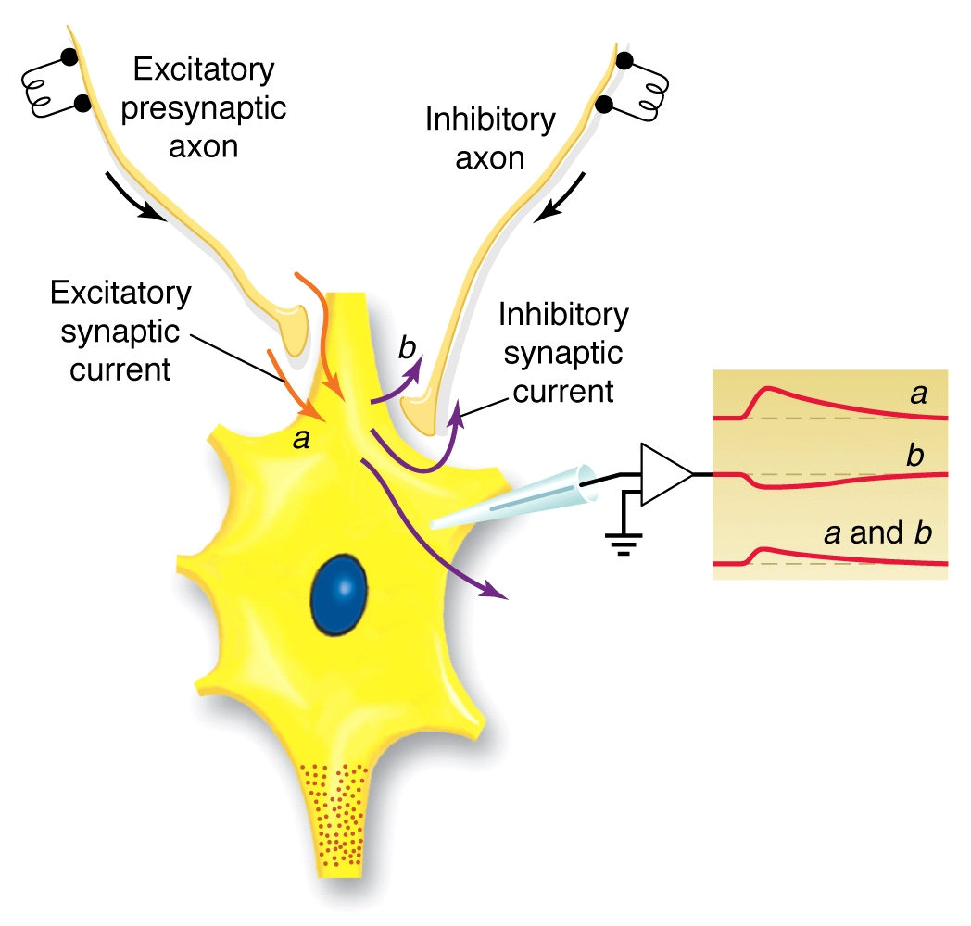

Slide 3
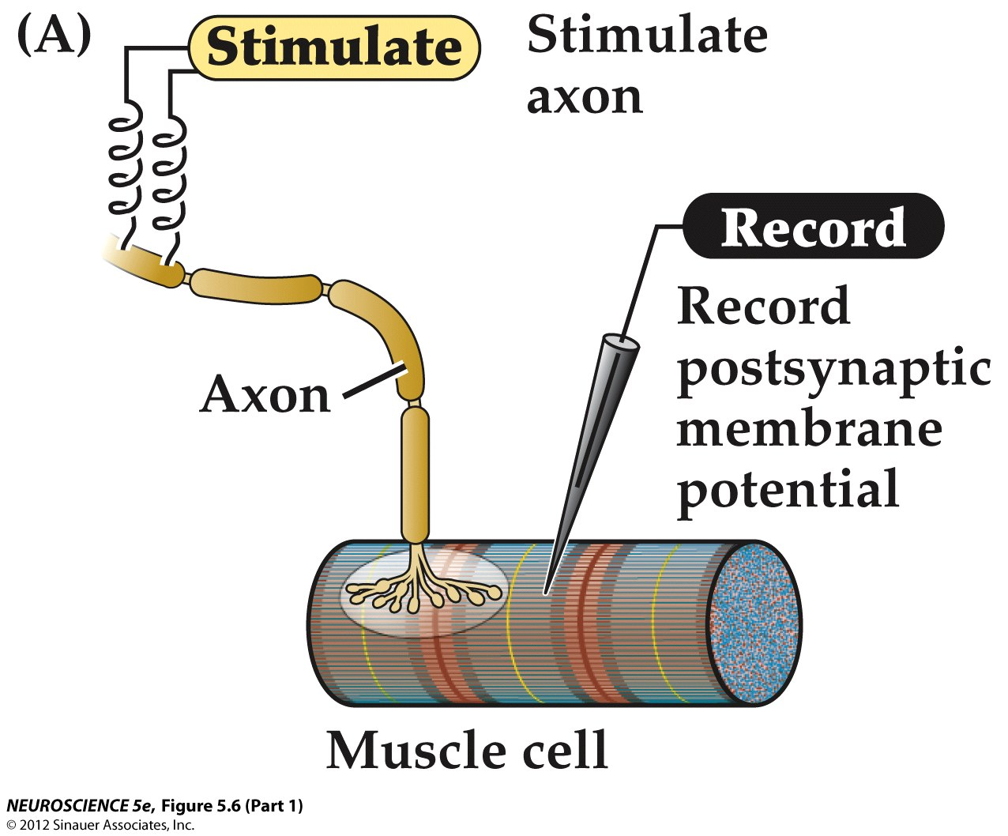
Figure 5.6 Synaptic transmission at the neuromuscular junction (Part 1)

Slide 4
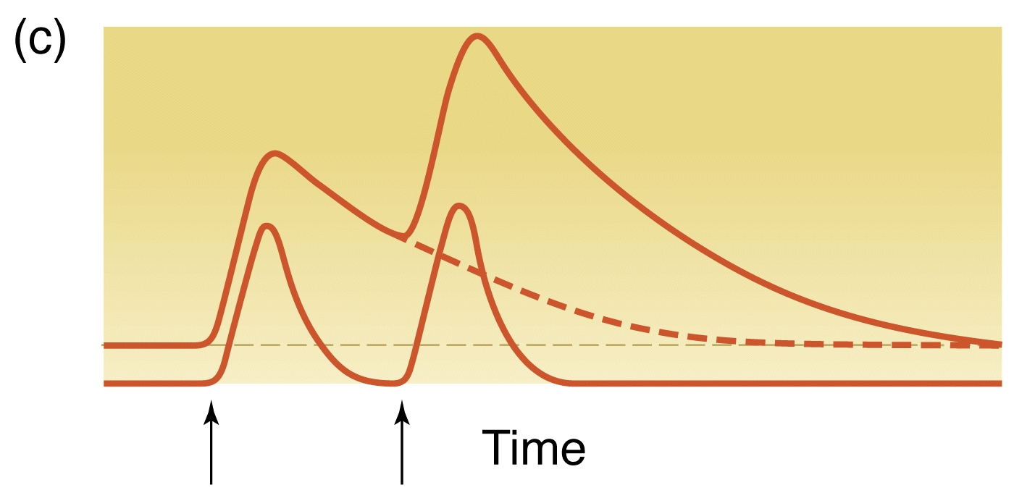

Slide 5
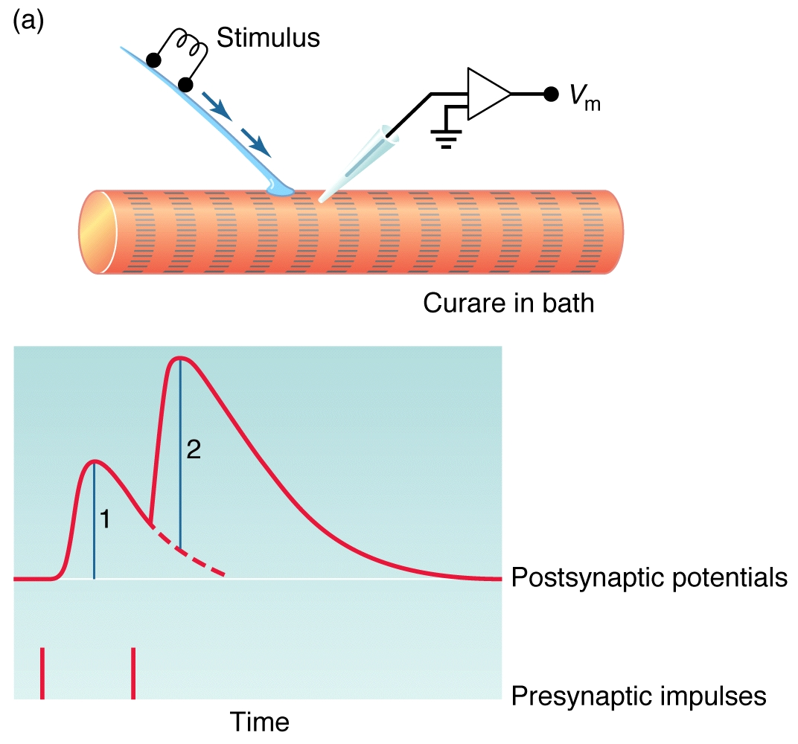

Slide 6
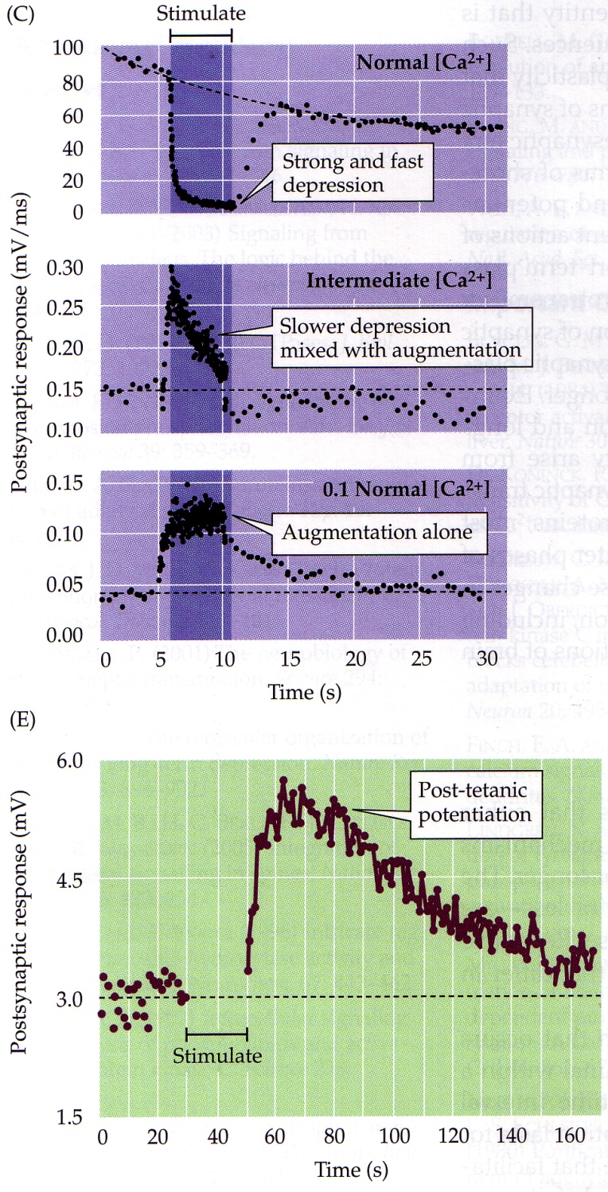

Slide 7
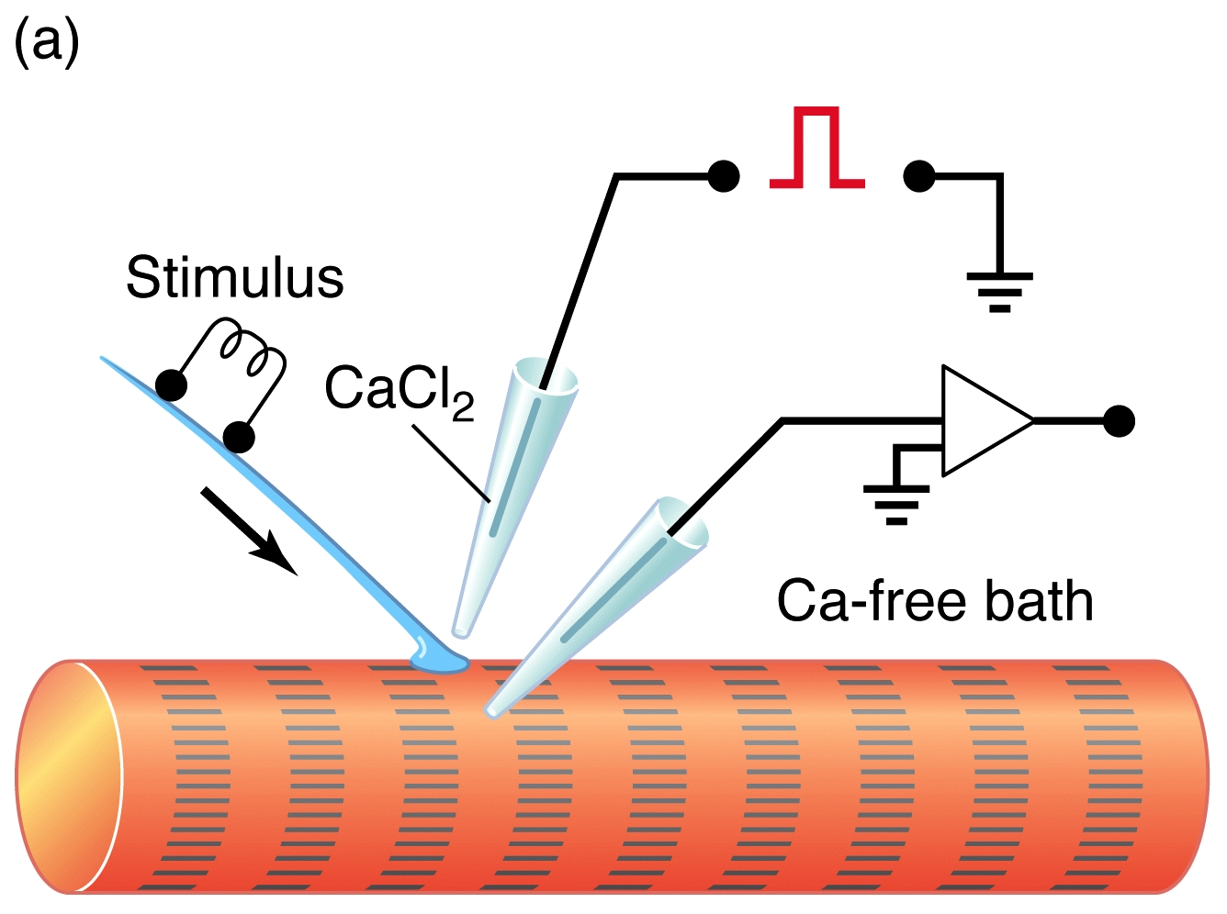

Slide 8
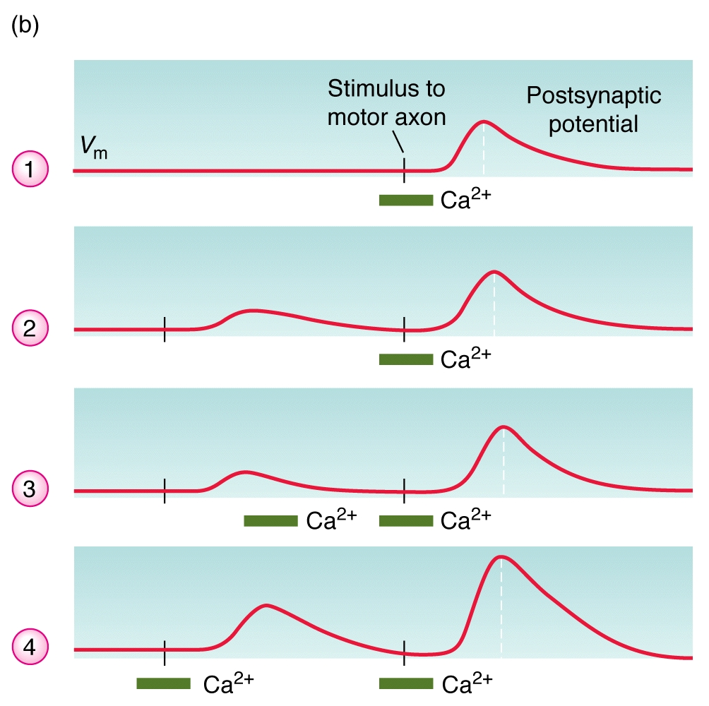

Slide 10
LTF and LTP: history
Experiments in crayfish might possibly be the first to demonstrate facilitation at the neuromuscular (NMJ) (Richet, 1879; also see Richet, 1881). Over the next few decades crayfish NMJs were being described anatomically and physiologically in respect to tension development and anatomy (Van Harreveld and Wiersma, 1936).
http://www.jove.com/video/1595/historical-view-and-physiology-demonstration-at-the-nmj-of-the-crayfish-opener-muscle
1953 that Fatt and Katz recorded transmembrane potentials of short term facilitation in crab muscle fibers.
With the seminal discover that the opener NMJ in crayfish exhibited long-term facilitation (LTF) (Sherman and Atwood, 1971), in addition to short-term facilitation, the mechanistic underpinnings for these phenomena needed to be addressed.
As a side note, long-term potentiation (LTP) was discovered in the vertebrate brain two years later (Bliss and L mo, 1973) without citation to the original discovery of the phenomenon at the crayfish NMJ.
Sherman, R. G., & Atwood, H. L. Synaptic facilitation: Long term neuromuscular facilitation in crustaceans. Science. 171, 1248 - 1250 (1971).
Bliss, T.V.P. & Lomo, T. Long-lasting potentiation of synaptic transmission in the dentate area of the anaesthetized rabbit following stimulation of the perforant path. J. Physiol. 232, 357 - 374 (1973).

Slide 11
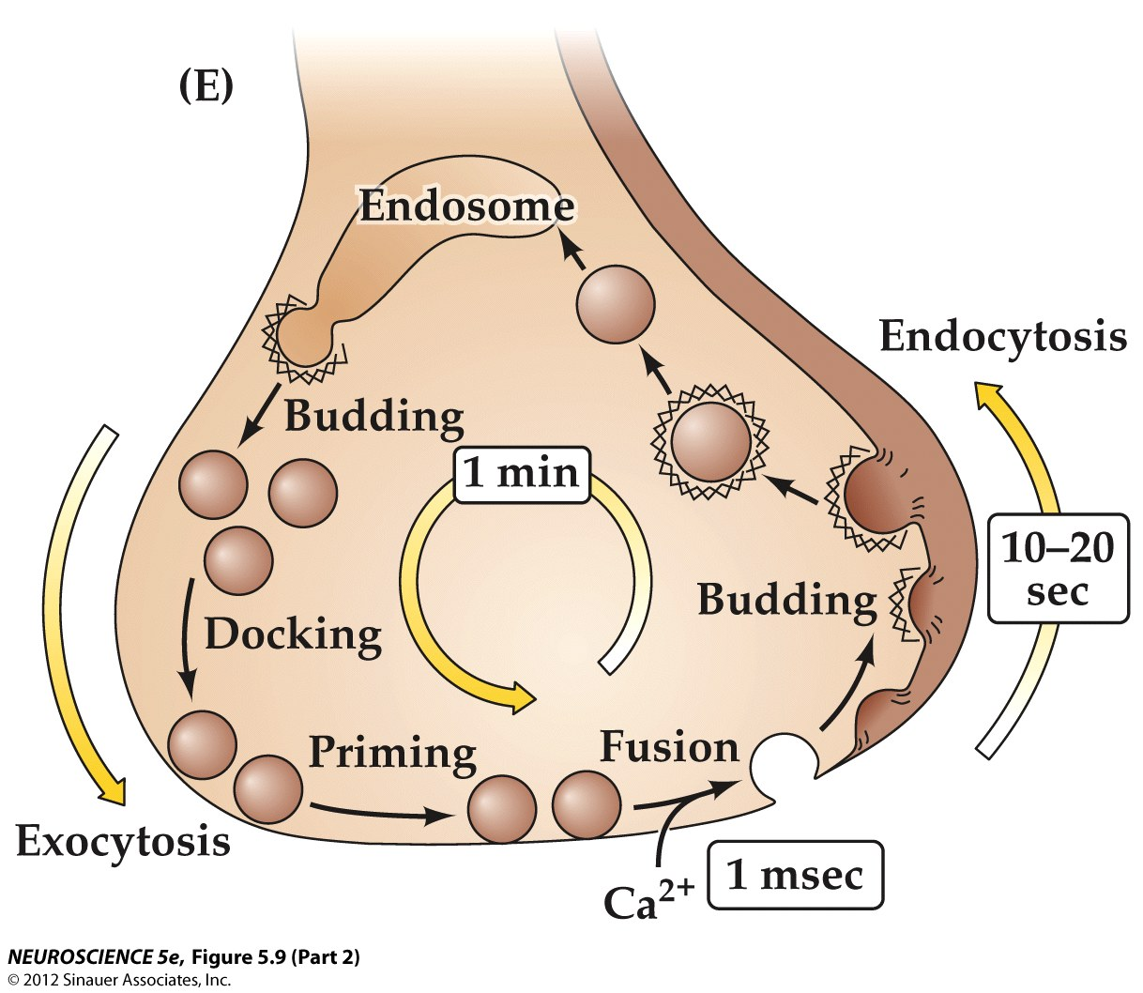
Figure 5.9 Local recycling of synaptic vesicles in presynaptic terminals (Part 2)

Slide 12
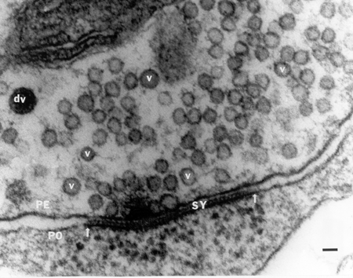

Slide 13
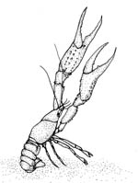
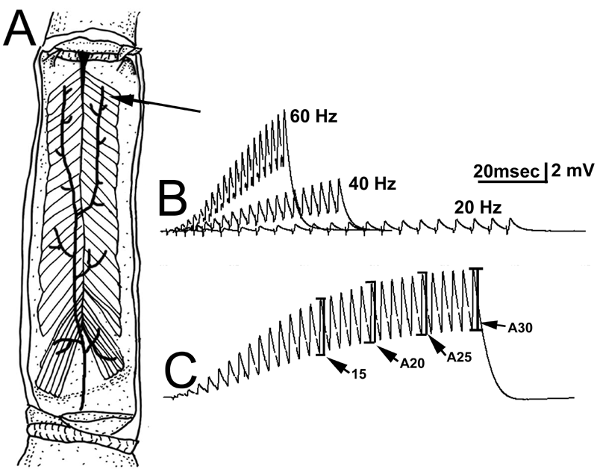
The schematic of the opener muscle in the crayfish walking leg in which the distal muscle fibers were recorded with an intracellular electrode.

Slide 14
40 Hz induced depression, but rejuvenated with 5-HT.
Depression is not due to a lack in vesicles.

Slide 15
Working Model
Two ways to reach targets
Ba
ES
Ba
Ba
Ba
3
2
Ba
Ba
1
Ba
Ba
Ba
Ba
Ba
Ba
Ba

Slide 16
High
Frequency
Stimulation
ES
3
2
1
Recycled vesicles can not be refilled again.

Slide 17
Depression
ES
3
2
1
Vesicles in RRP are empty.

Slide 18
Add 5-HT
ES
3
2
1
5-HTR
5-HT recruits vesicles from RP.
5-HT

Slide 19
With 5-HT
ES
3
2
1
5-HTR
5-HT
Fully packed vesicles in RP are decreased.

Slide 20
Depression
Again
ES
3
2
1
5-HTR
5-HT
Vesicles in both RP and RRP are empty.

Slide 21
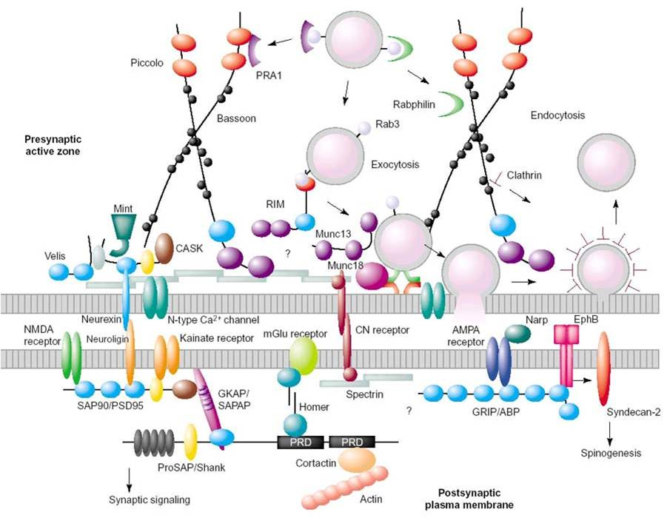
Zhang and Jin, 2004, Curr. Opin. Neurobiol
Notes:
Zhang and Jin, 2004, Curr. Opin. Neurobiol

Slide 22
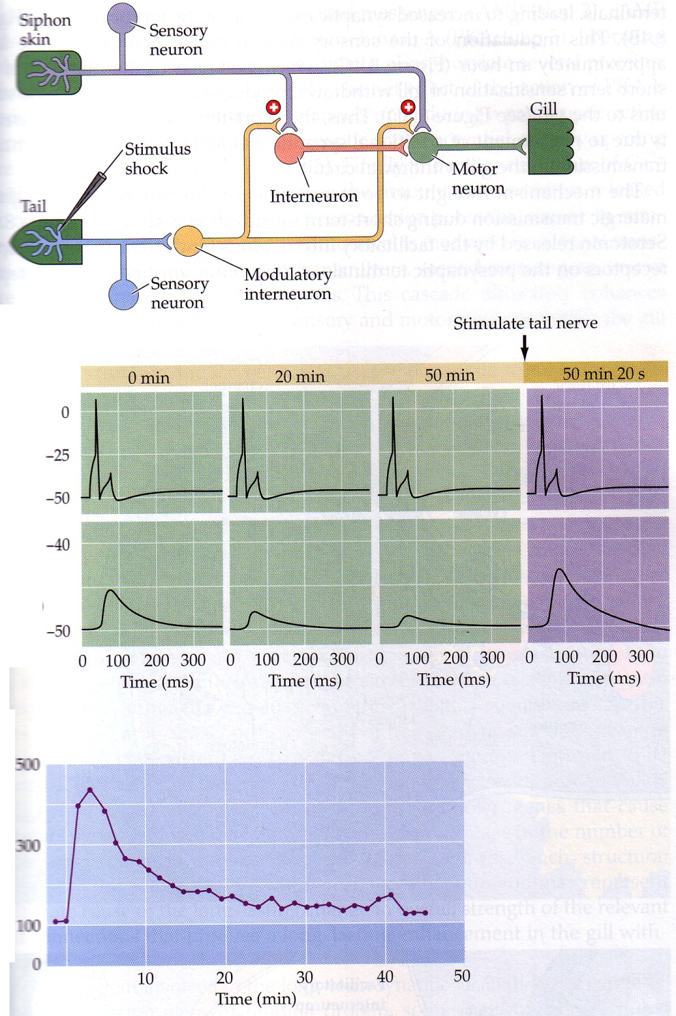

Slide 23
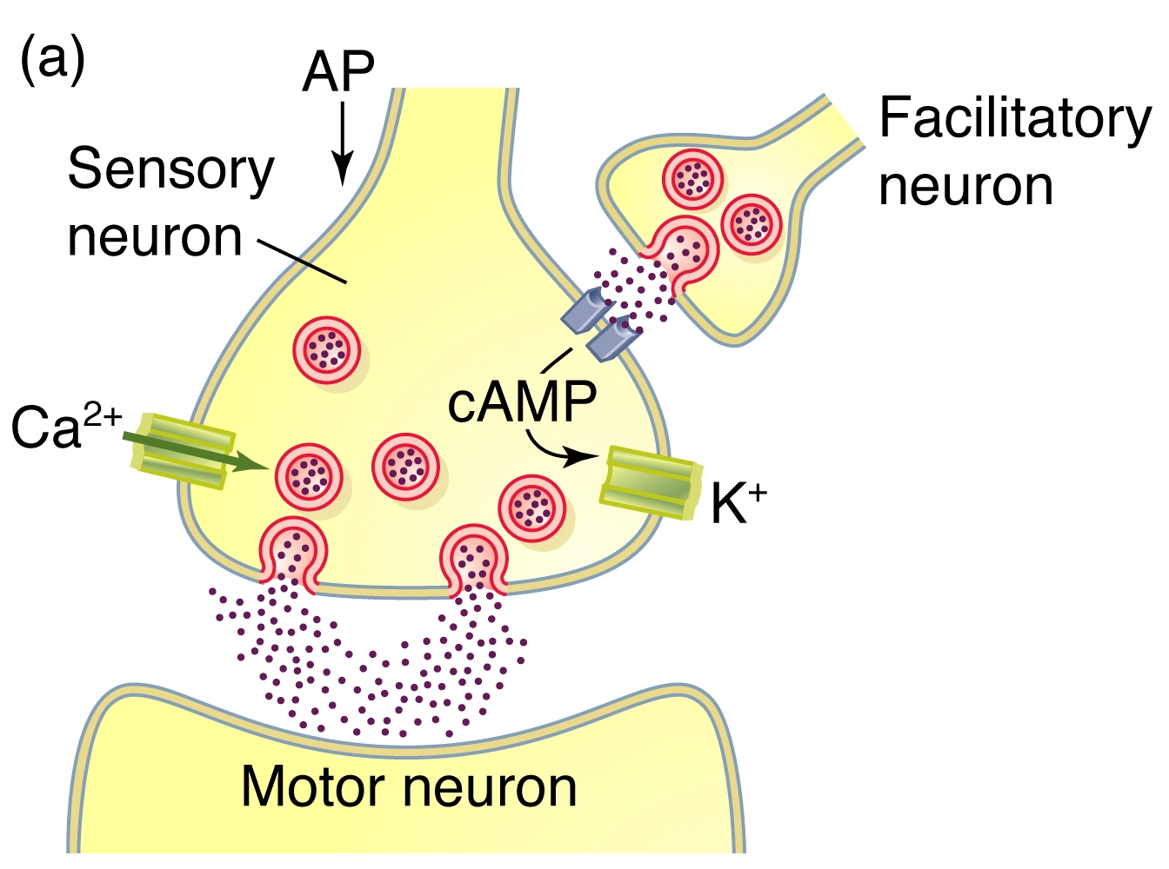
5-HT
PKA
Closes K channel

Slide 24
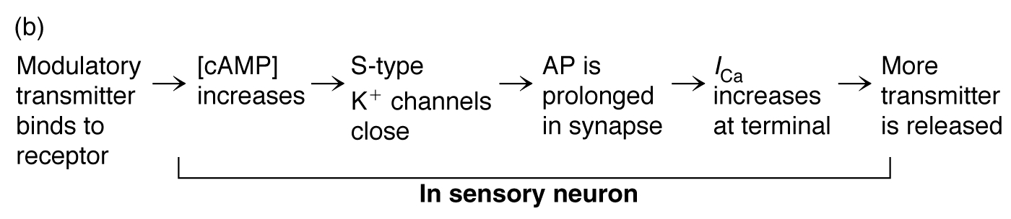

Slide 25
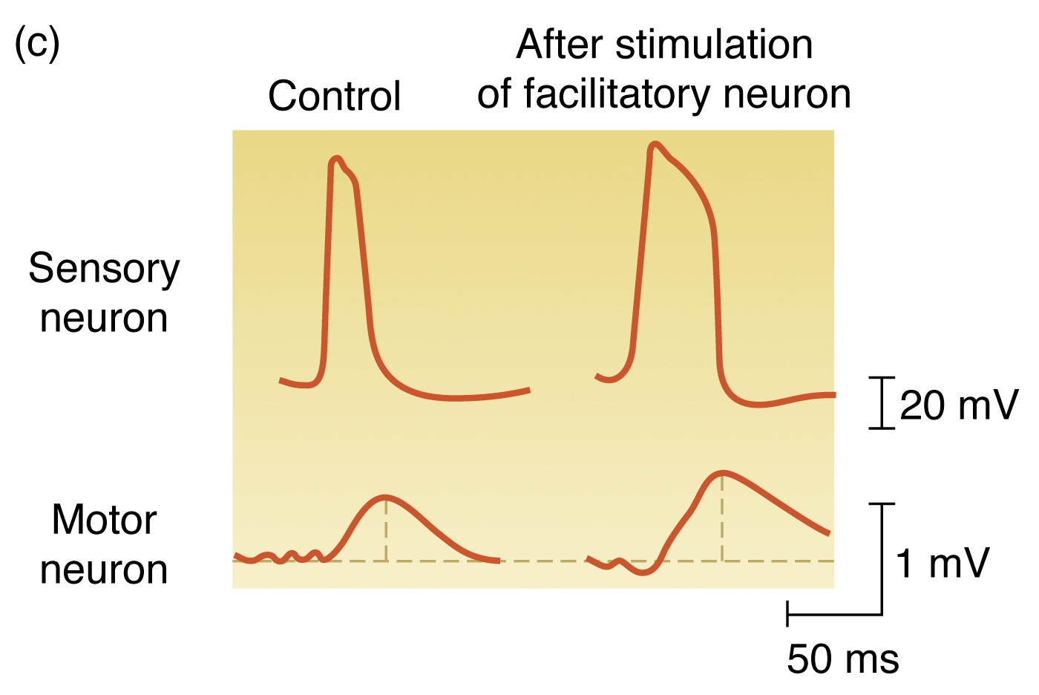

Slide 26
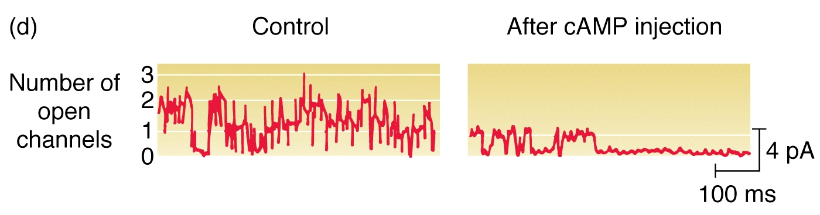

Slide 27
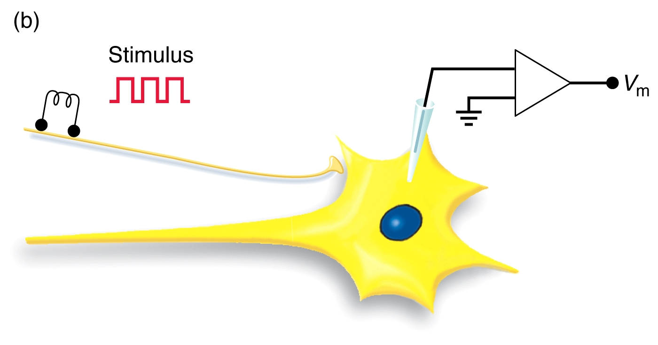

Slide 28
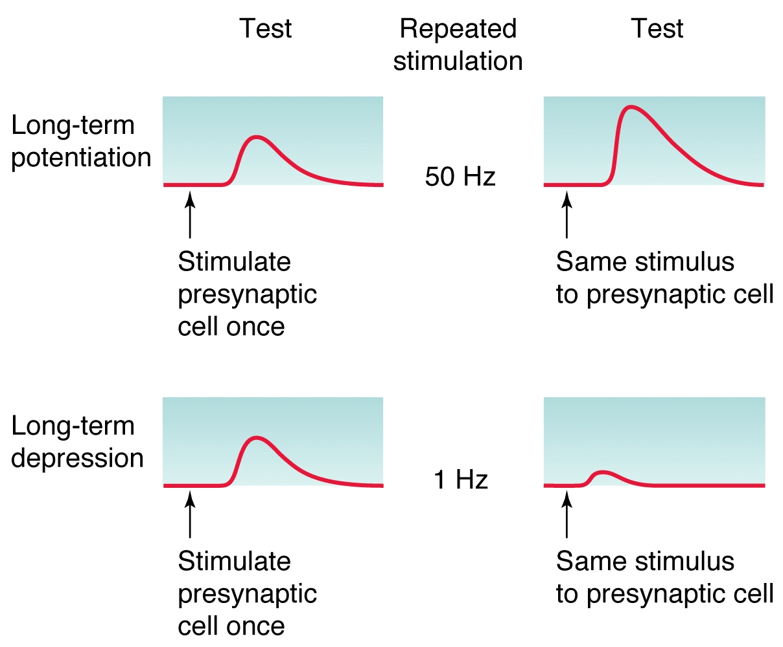

Slide 29
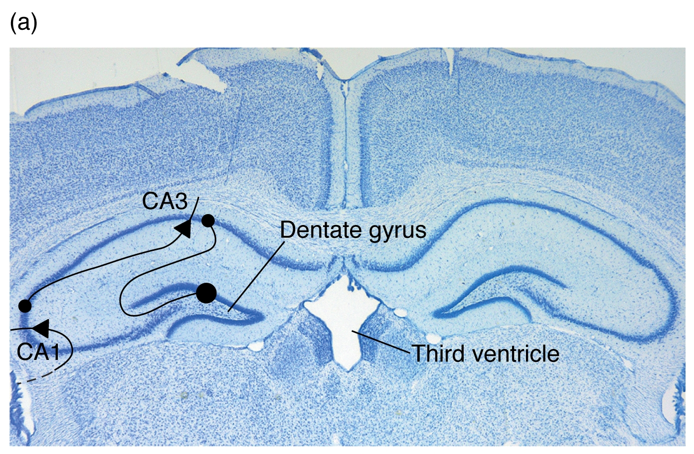

Slide 30
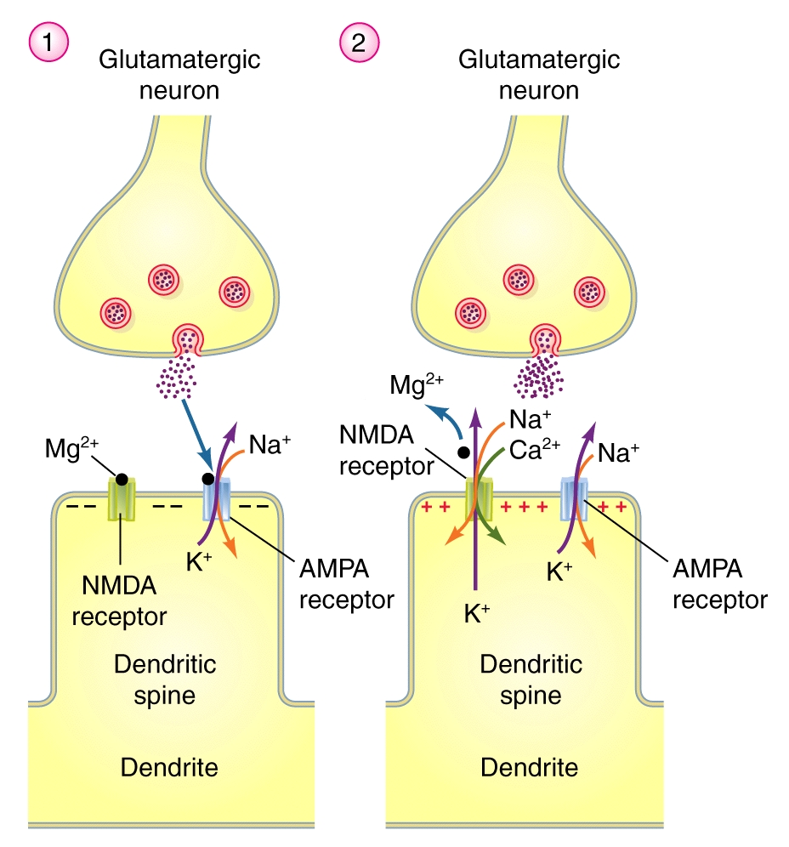

Slide 31
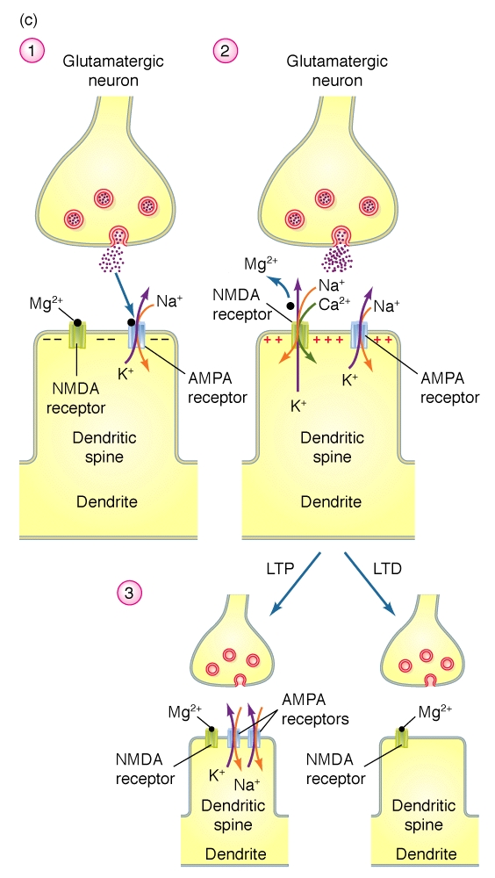

Slide 32
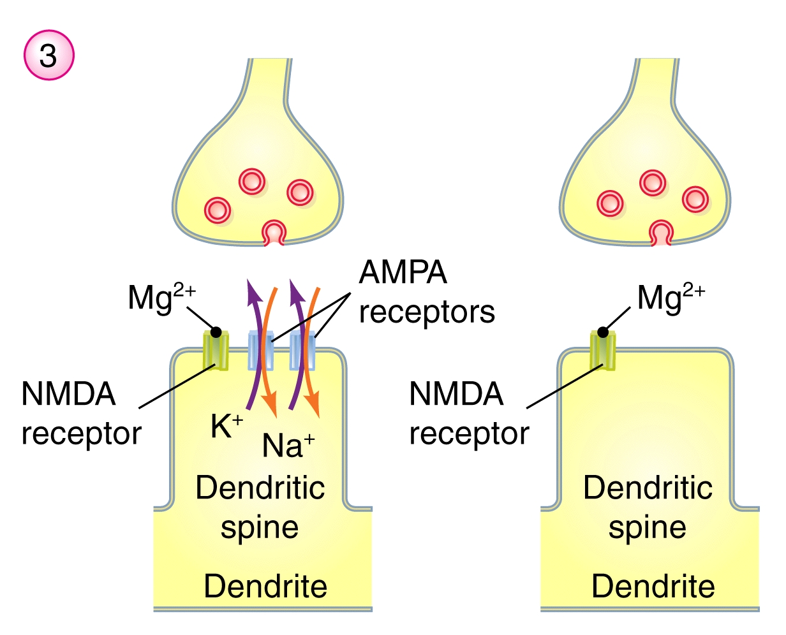

Slide 33
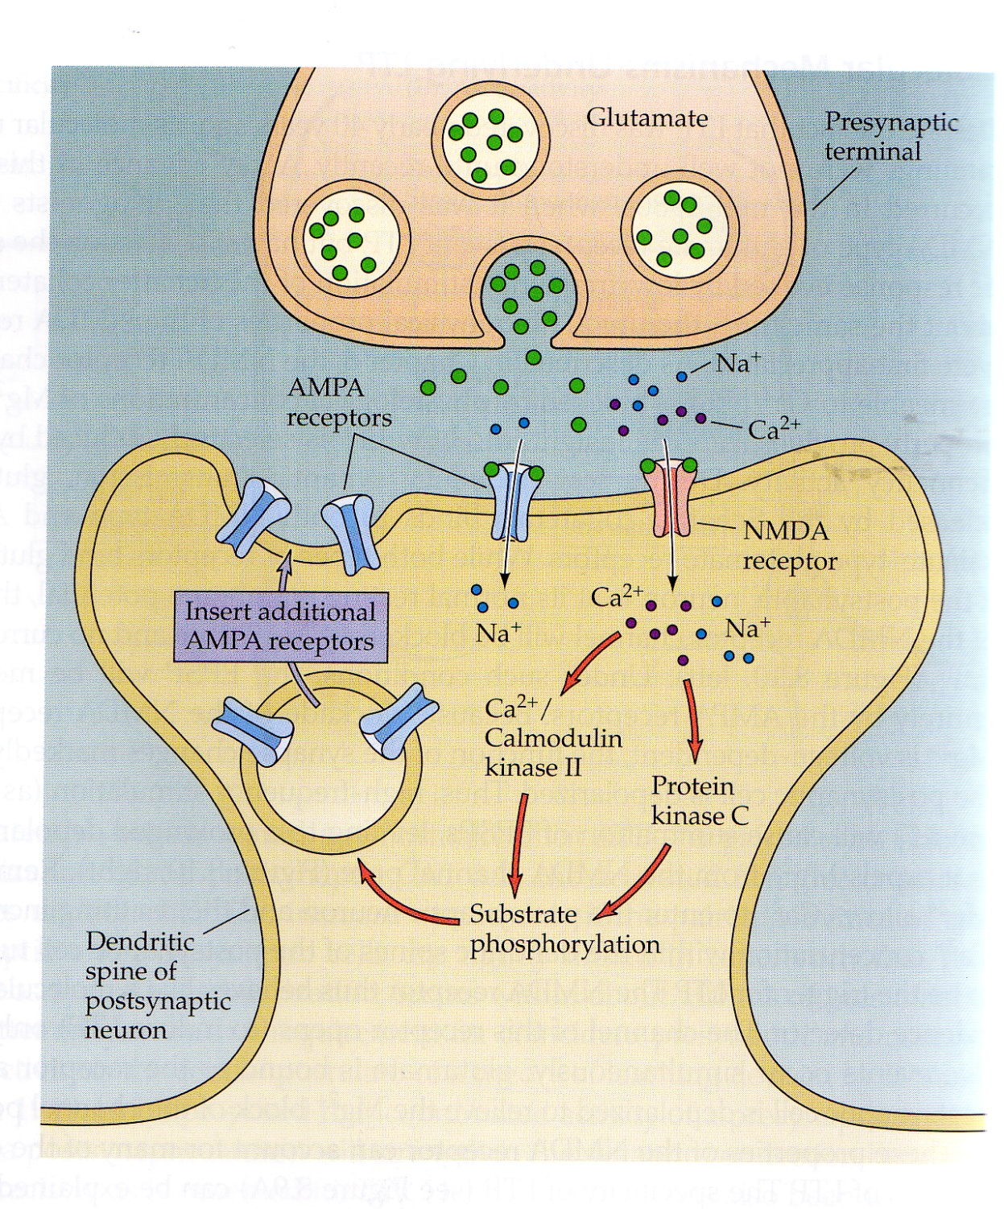

Slide 34
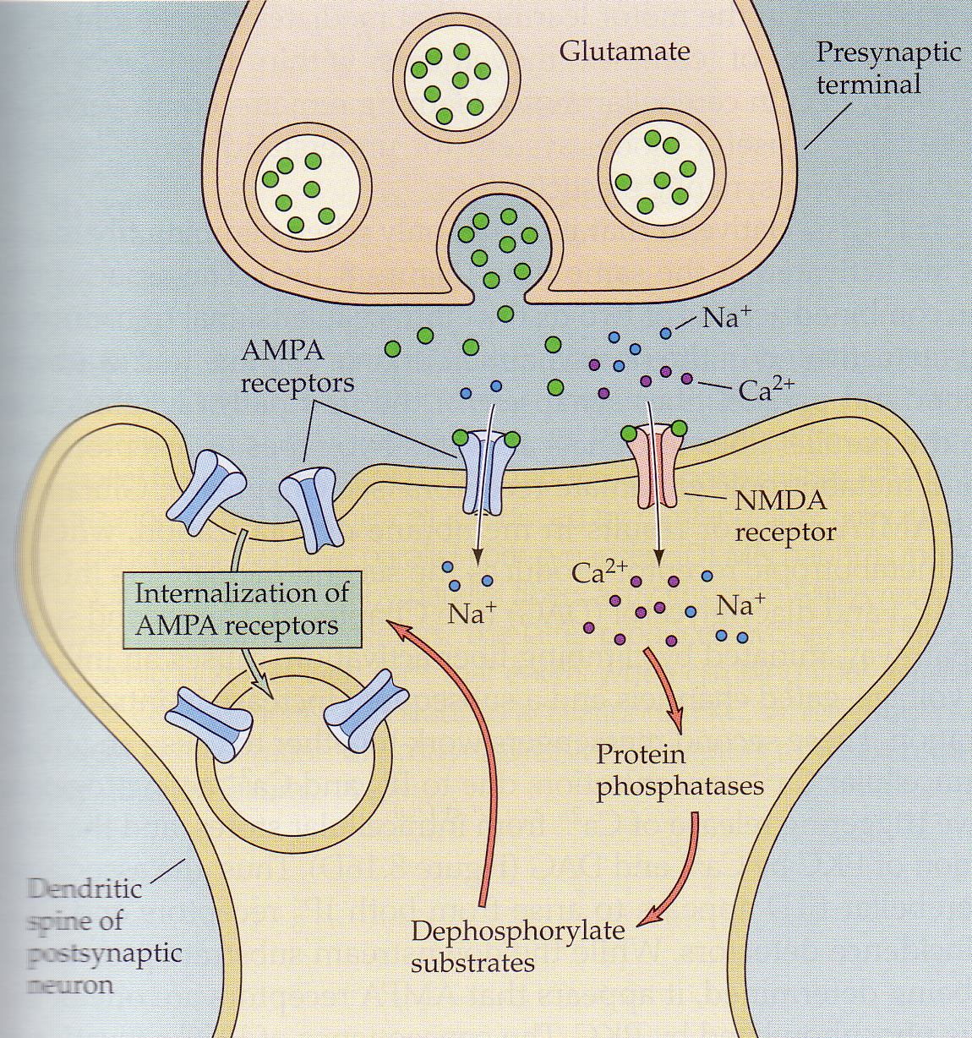

Slide 35
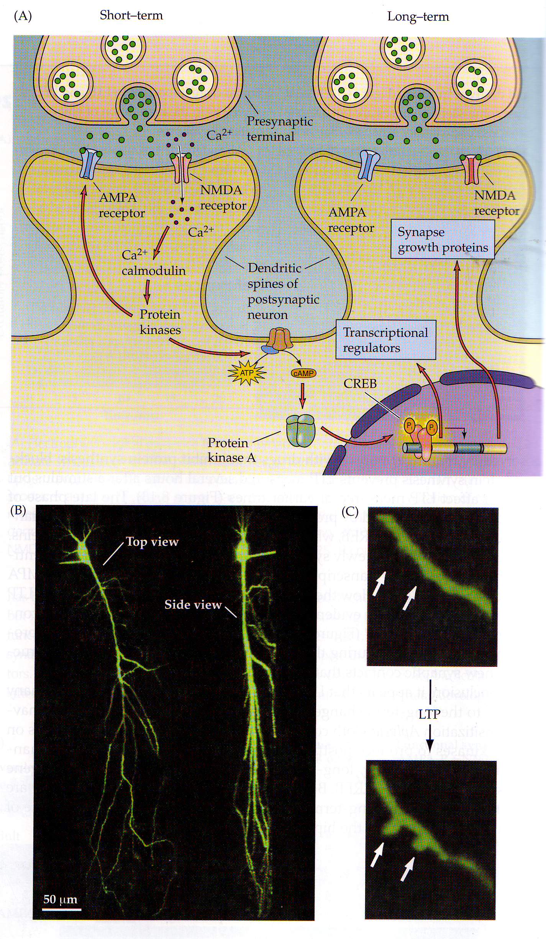

Slide 37
